Slide 1

RESUME CLASSIFICATION

Slide 2
Group Members
MR. Suraj Laxman Kadam
Ms. Rashika Anantrao Shrirame
Arukala Kavya
Ms. Saloni Kailas Malpani

Slide 3
INDEX
Introduction
Code Overview
Data Pre-processing
Exploratory Data Analysis
Model Building
Hyperparameter Tuning
Model Interpretation
Model Deployment

Slide 4
INTRODUCTION
Introduction to the project: "Automating the process of resume classification is crucial for efficient HR and recruitment processes.“
Importance: "Manual resume screening can be time-consuming and error-prone, leading to inefficiencies in hiring.“
Objective: "The objective of this project is to develop a system that automates the extraction of text from resumes and classifies them into relevant categories using Natural Language Processing (NLP) and Machine Learning (ML) techniques."

Slide 5
Code Overview
Overview: "The code implements various NLP and ML techniques to preprocess resumes, extract relevant information, and classify them into predefined categories.“
Libraries Used: "The code utilizes libraries such as pandas, nltk, sklearn for data processing, analysis, and model building.“
Functionality: "It automates tasks such as text extraction, cleaning, tokenization, and classification, streamlining the resume screening process."

Slide 6
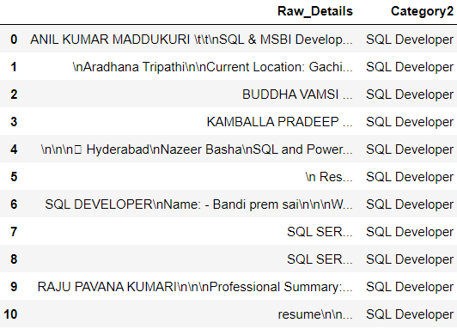
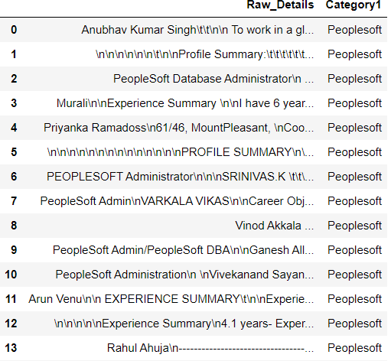
Original Dataset
As We see in original Dataset we have improper structure like
In this we saw some hyper links,\n,\t, some letters are in capital some are in small.
So for converting this type of improper structure data into proper structure data we are go through the “Data Pre-Processing”

Slide 7
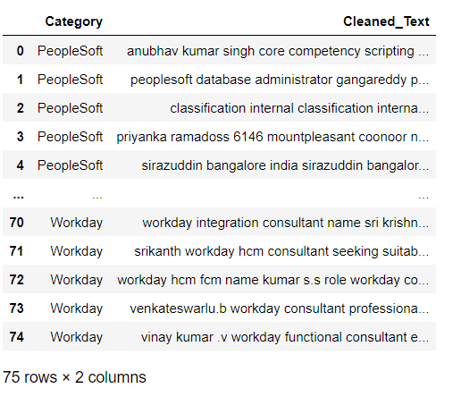
Data Pre-Processing
"Data preprocessing involves cleaning the text, tokenization, stopwords removal, and lemmatization to prepare the data for classification.“
Techniques Used: "Text normalization techniques ensure consistency and accuracy in the extracted information, improving the performance of the classification model."

Slide 8
Exploratory Data Analysis
We have extracted the information from the given resumes and performed data preprocessing using Natural Language Processing techniques .
After we got the cleaned dataset from it then we performed some EDA to get useful insights from the available information.
EDA provides valuable insights into the distribution of job titles, skill word frequencies,experiences and text length of resumes.

Slide 9
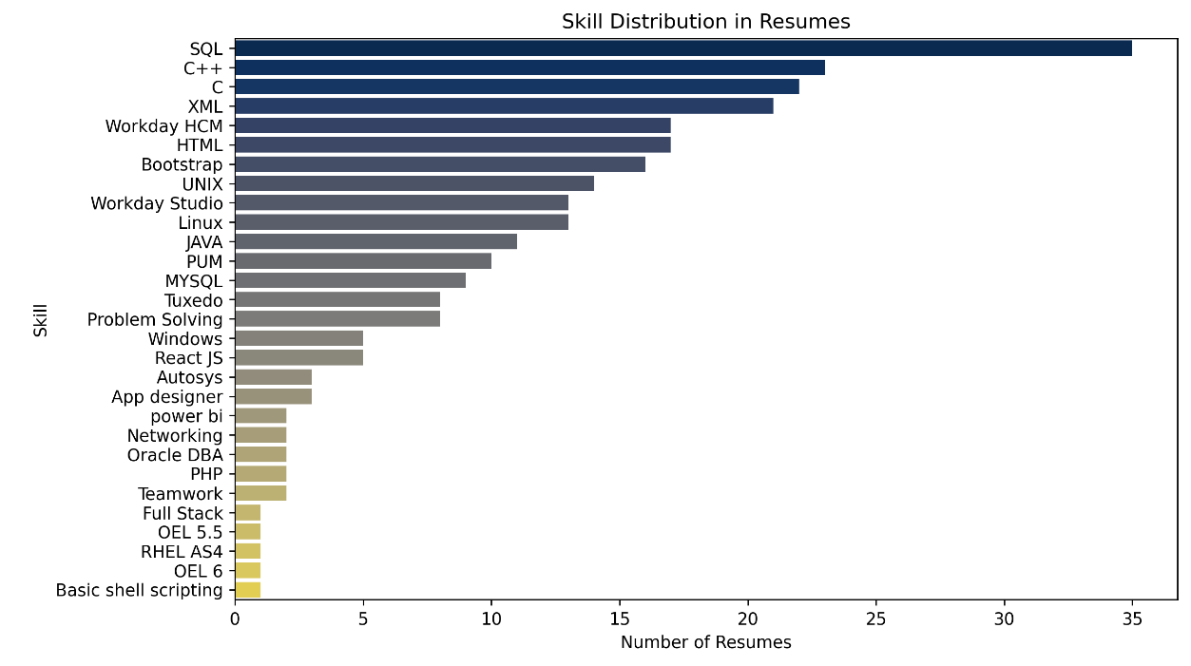
Skills in All Categories:

Slide 10
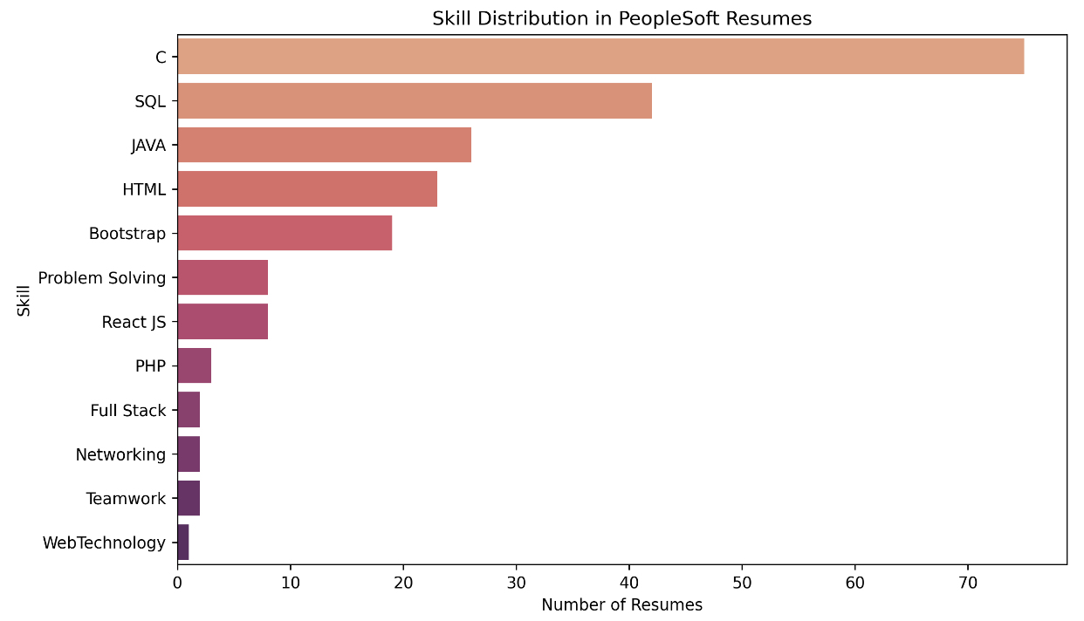
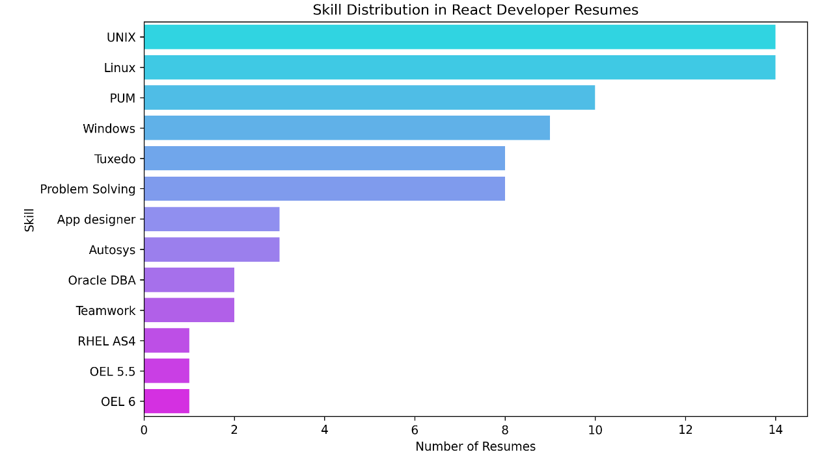
Skills in PeopleSoft Category:
Skills in React Developer Category:

Slide 11
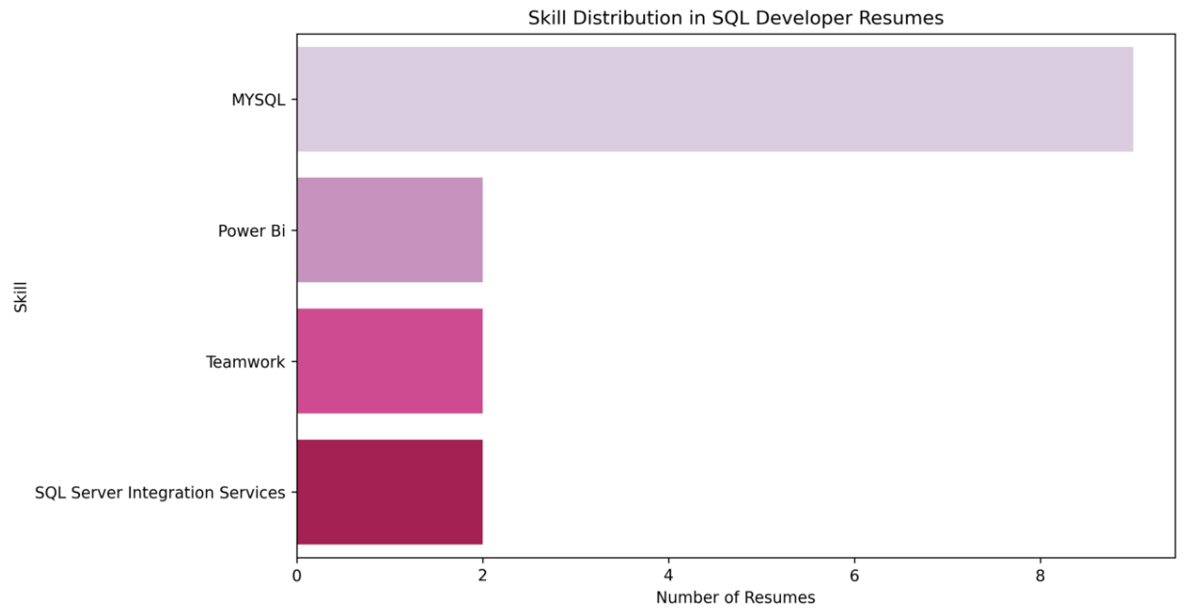
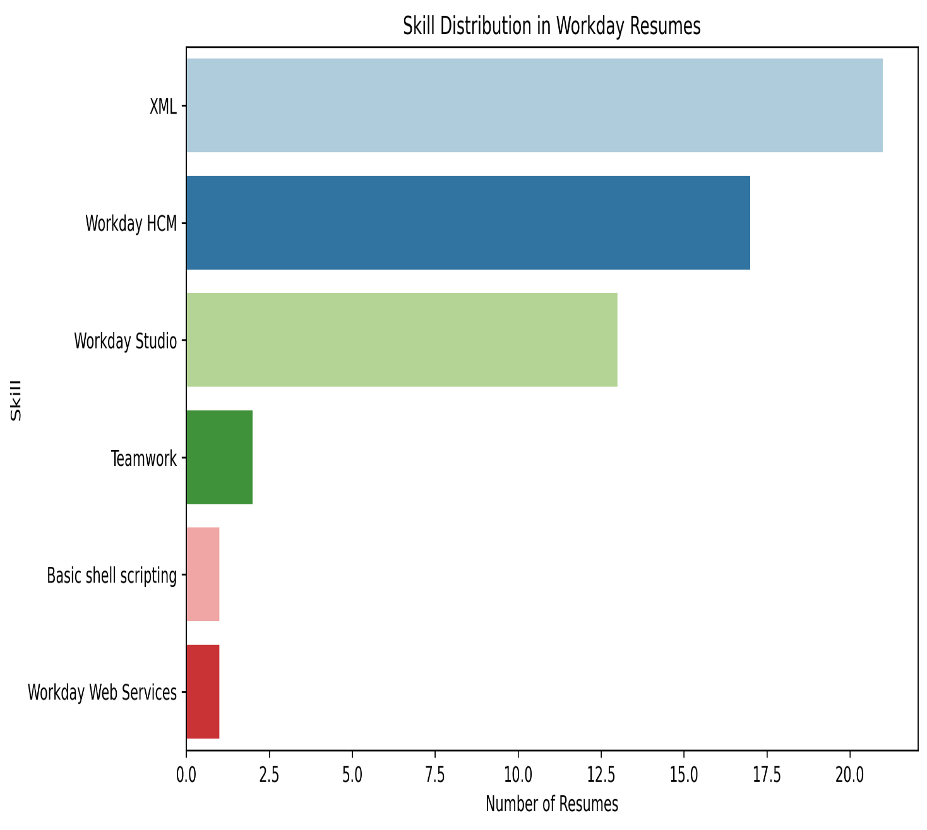
Skills in SQL Developer Category:
Skills in Workday Category:

Slide 12
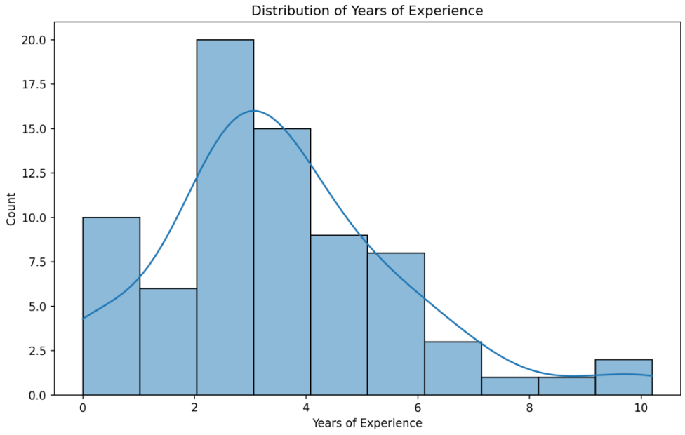
Experience:

Slide 13
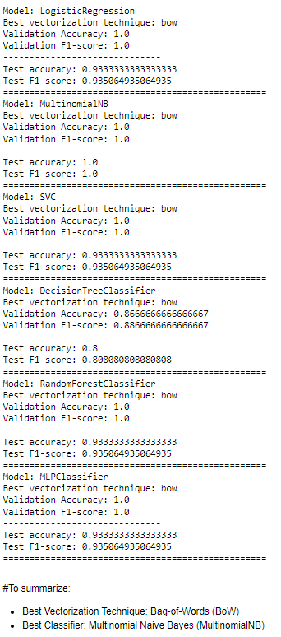
MODEL BUILDING
Techniques: "Various classification algorithms such as Multinomial Naive Bayes, Logistic Regression, and Decision Trees are used for model building.“
Feature Extraction: "Feature extraction techniques such as Bag-of-Words, TF-IDF, and Word2Vec are employed to convert text data into numerical representations.“
Selection: "The best performing model and vectorization technique are selected based on validation metrics such as accuracy and F1-score."

Slide 14
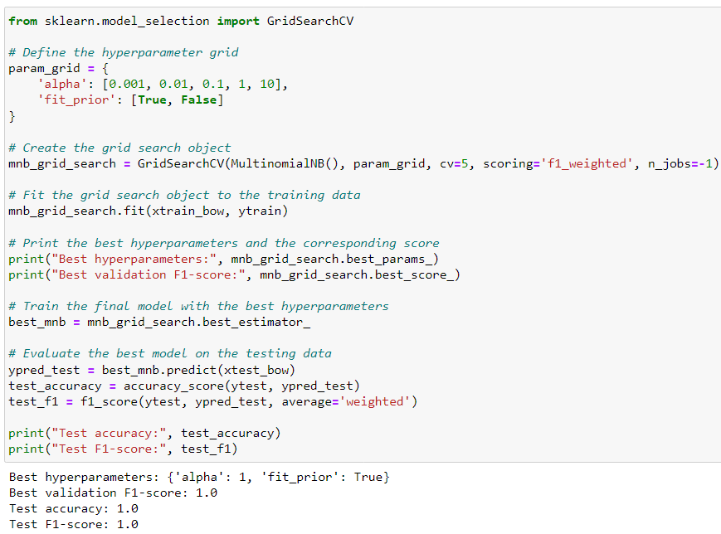
Hyperparameter Tuning
Optimization: "Hyperparameter tuning using techniques like GridSearchCV optimizes model performance by selecting the best combination of hyperparameters."
Importance: "Fine-tuning hyperparameters ensures the model's robustness and generalization on unseen data."

Slide 15
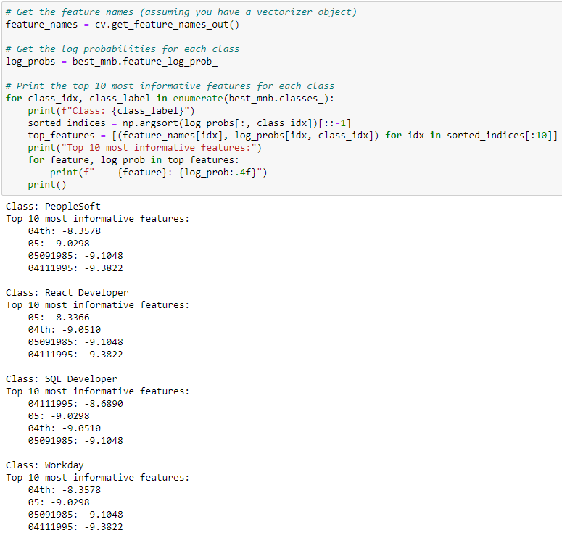
Model Interpretation
Interpretability: "The top informative features for each class provide insights into the factors influencing the classification decisions."
Understanding: "Understanding the model's interpretation enhances trust and confidence in its predictions."

Slide 16
MODEL DEPLOYMENT
Streamlit: "The model is deployed using Streamlit, enabling easy access and usage for real-world applications.“
Benefits: "Automating the resume classification process streamlines HR operations, saving time and resources."

Slide 17
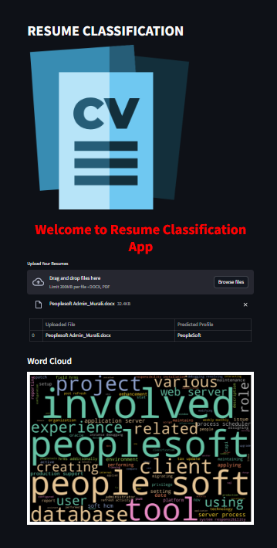
Here We are using the Streamlit Platform for deployment of our project.
After deployment we get this type of web page in which we select the file are wee got to know the type of resume file and skills in that resume file.

Slide 18
Thank You….

